Slide 1
Members of Project 1.Sanket Sacheti 2.Pankhuri Sharma 3.Pragathi 4.Vamsi
Real and Fake News Detection

Slide 2

Classify News Article as Real or Fake
Objective

Slide 3



Dataset Overview
True News
Fake News
Balanced Representation
Collected from credible news outlets
Verified content
Fact-checked to ensure accuracy
Gathered from unreliable or disreputable sources.
They generally include
sensational headlines
fabricated stories
misleading information
Balanced representation of news content
Enabling a robust and unbiased analysis

Slide 4
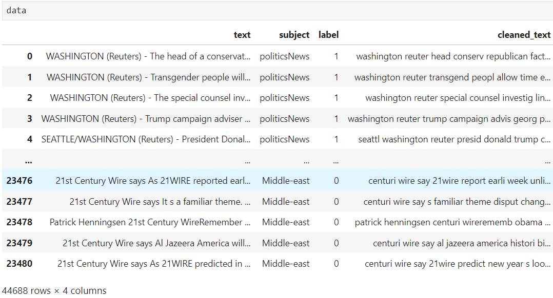
Import Python Libraries
Reading Dataset
Analyzing the data using data.head() ,data.shape (),data.info()
Check for Duplicate Values
Imputation of Missing Values.
Text Cleaning.
Apply stemming and lemmatization.
Post cleaning formation of word cloud
Steps to EDA

Slide 5
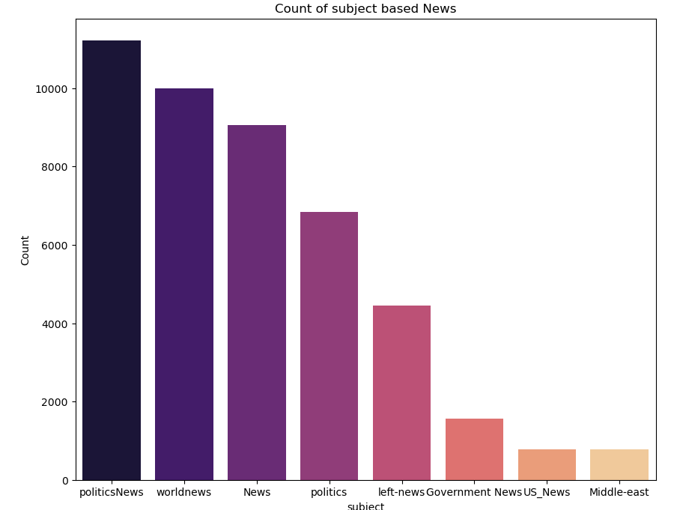
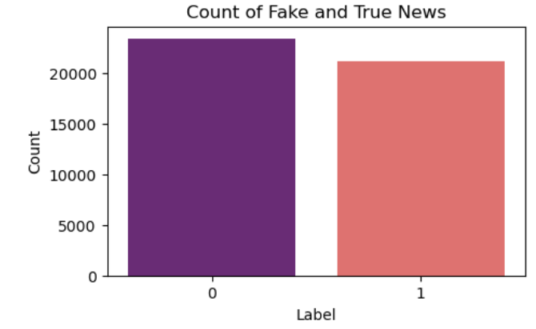
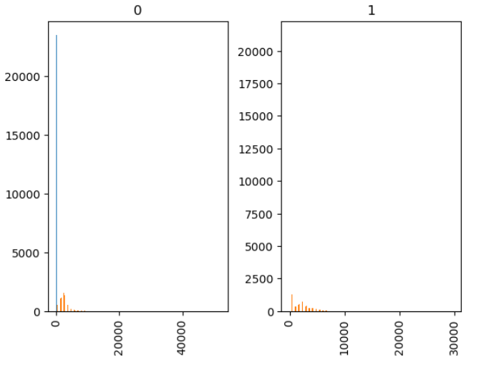
Visualization
Length of Text in dataset

Slide 6
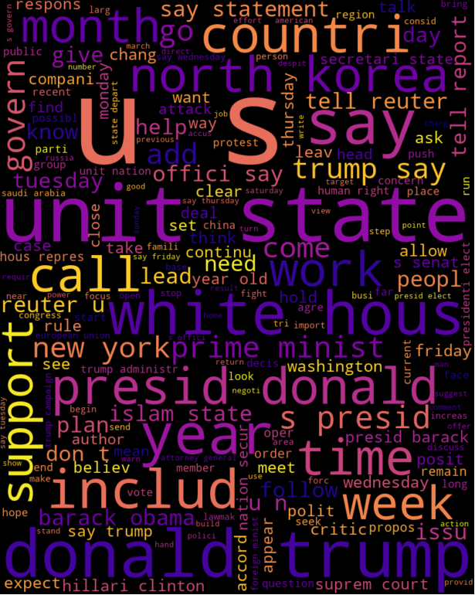
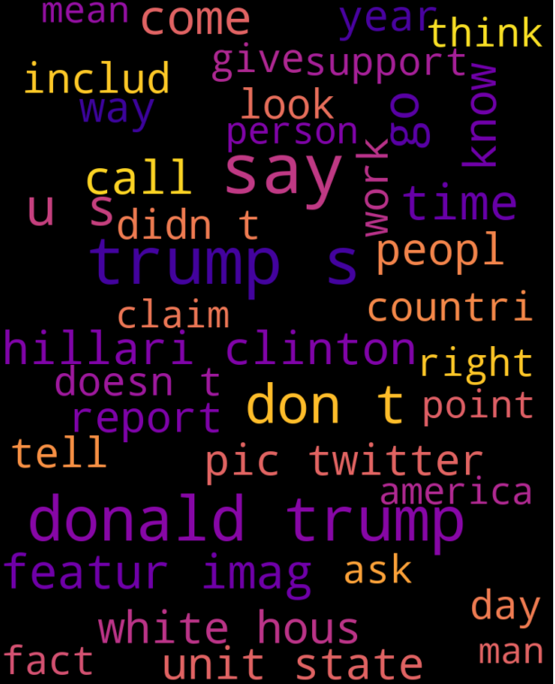
Word Clouds
True News Word Cloud
The word cloud for the true news dataset highlights the prevalence of keywords related to factual reporting, such as "government," "economy," and "policy." This reflects the emphasis on objective, well-researched information in legitimate news sources.
Fake News Word Cloud
In contrast, the word cloud for the fake news dataset features more emotive and sensational words, such as "scandal," "controversy," and "outrage." This suggests a focus on attention-grabbing narratives rather than balanced, fact-based reporting

Slide 7

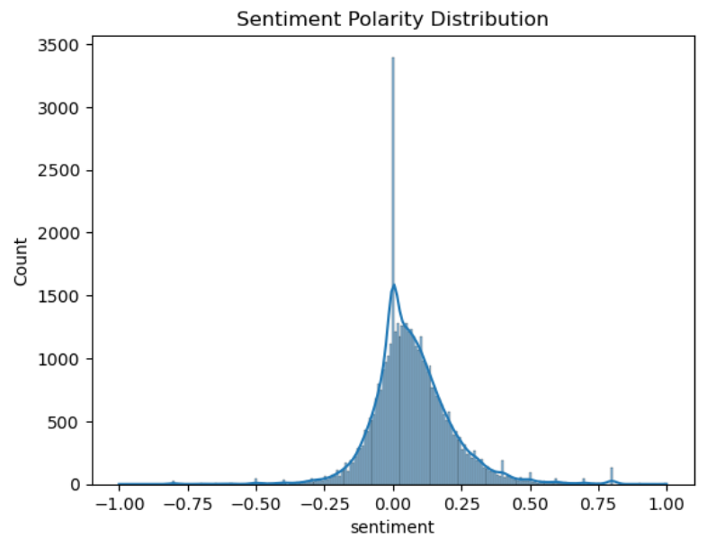
Sentiment Analysis
Positive Sentiment
The sentiment analysis reveals a higher proportion of positive sentiment in the true news articles, reflecting a more balanced and objective tone.
Negative Sentiment
Fake news articles, on the other hand, tend to express more negative sentiment, often using emotive language to elicit strong reactions from readers.
Neutral Sentiment
True news articles also exhibit a greater degree of neutral sentiment, suggesting a more impartial and fact-based reporting style.

Slide 8
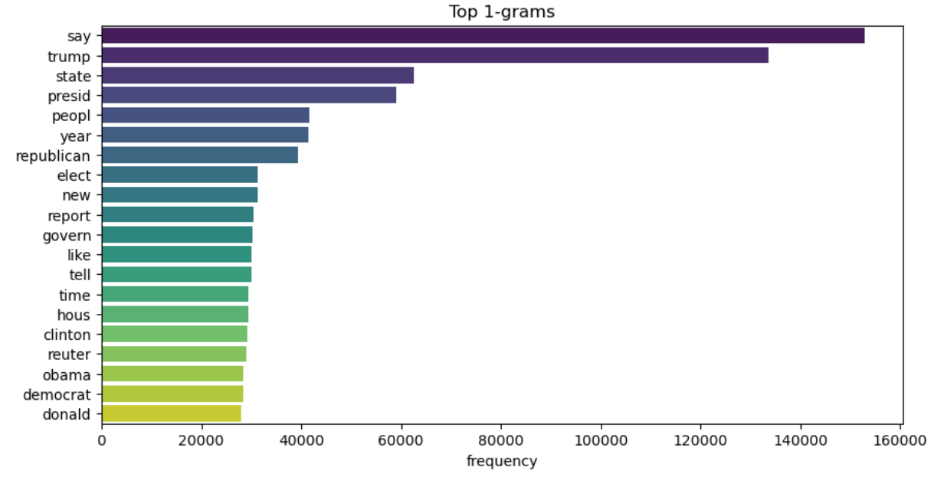
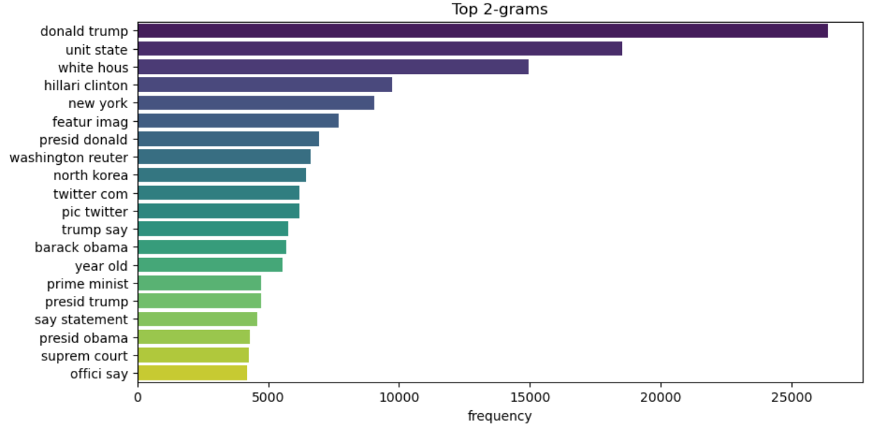
N-Gram Analysis in Natural Language Processing (NLP) N-Gram Analysis is a fundamental technique in Natural Language Processing (NLP) used to analyze sequences of words or characters in a text. It helps capture the context and relationships between words by considering sequences of 'n' items (where 'n' can be 1, 2, 3, etc.).

Slide 9
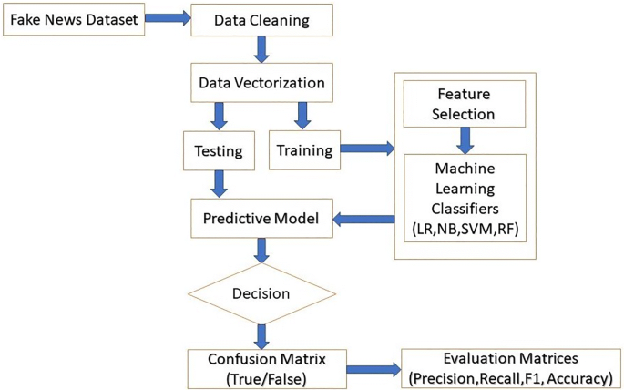
Fake News Detection Flowchart
Feature Engineering
Key linguistic and structural features are extracted from the news articles, including sentiment, readability, and network-based characteristics.
Model Training
Machine learning algorithms are trained on the labeled true and fake news datasets to develop a robust classification model.
Model Evaluation
The model's performance is assessed using various metrics, such as accuracy, precision, recall, and F1-score, to ensure its effectiveness in detecting fake news.

Slide 10
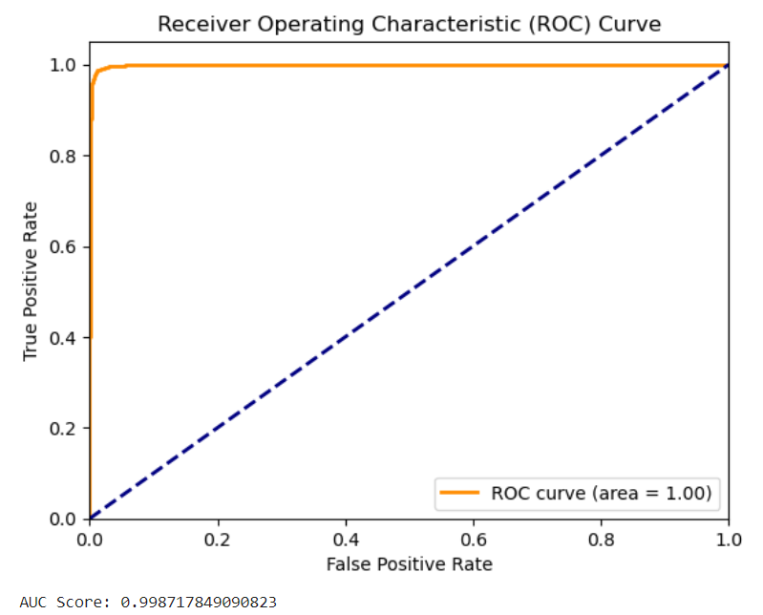
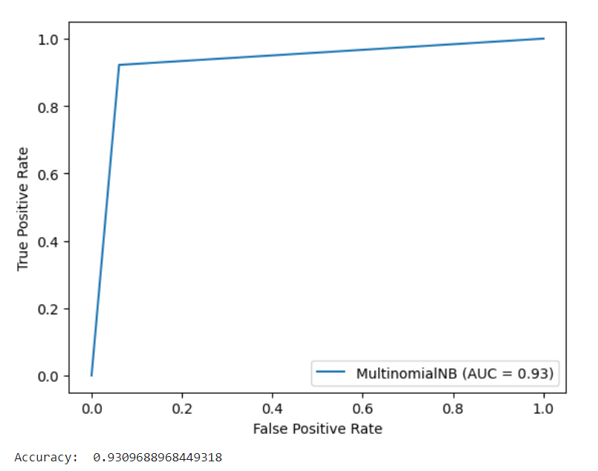
Performance of ML Models with ROC Curve and Accuracy
Logistic Regression
A simple yet effective model for binary classification. It predicts the probability of a news article being true or fake based on the features extracted from the text.
Accuracy:99.87
2. Naive Bayes
A probabilistic model based on Bayes' theorem, assuming independence between features. It works well with text data, especially in handling large vocabularies
Accuracy:93.26

Slide 11
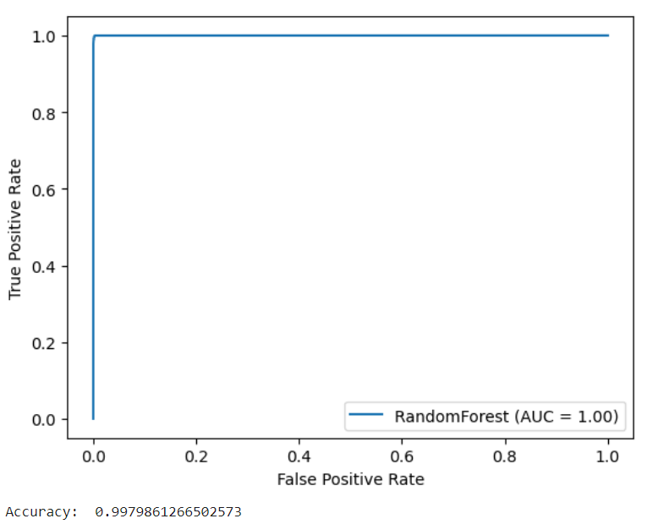
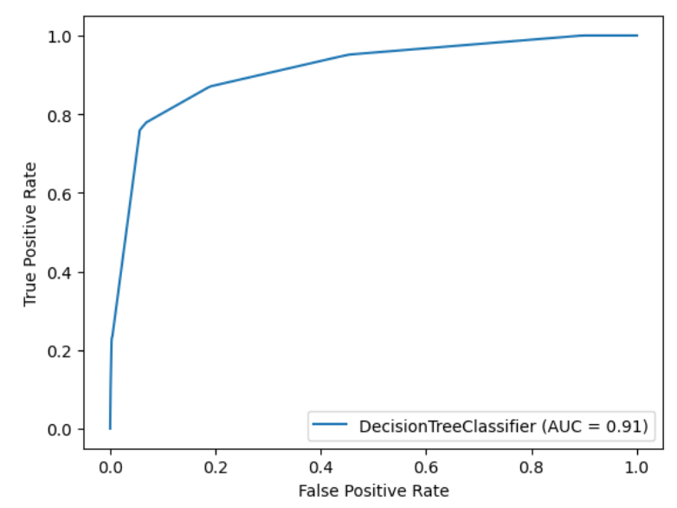
3. Random Forest Classifier
An ensemble model that builds multiple decision trees and merges them to improve prediction accuracy and control overfitting.
Accuracy:99.79
4. Decision Tree Classifier
A Decision Tree Classifier is a model that uses a tree-like structure to make decisions based on input features. It splits the data into branches to predict whether the news is true or fake. Each node represents a decision based on a feature, and the leaves represent the final classification.
Accuracy: 93.09

Slide 12
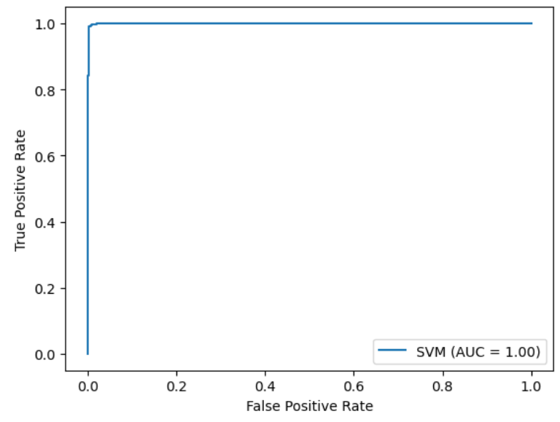
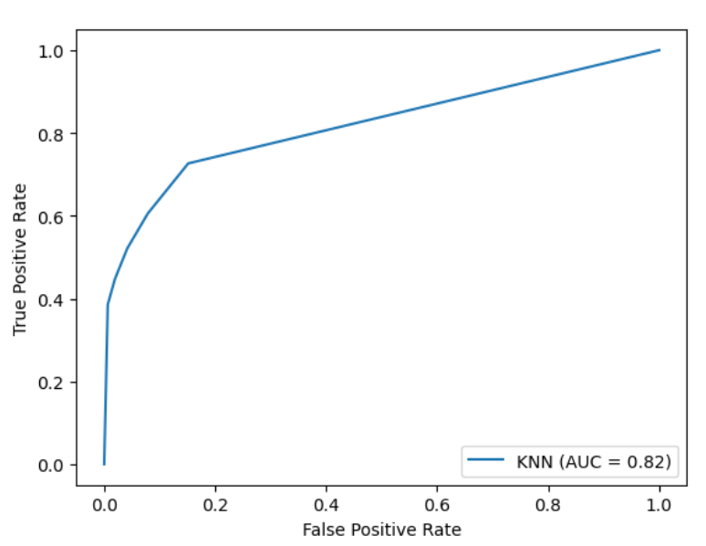
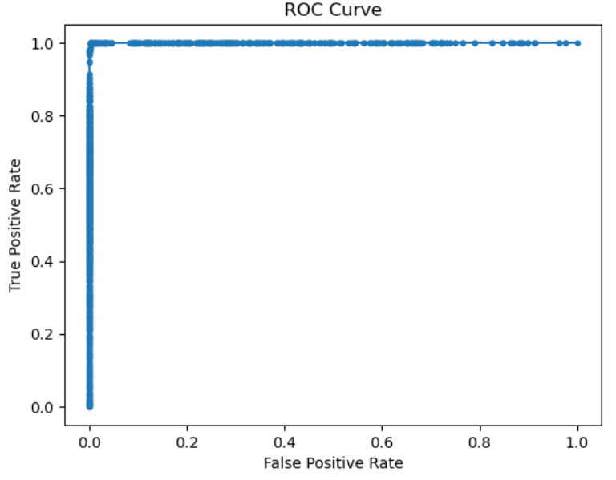
5. Support Vector Machine (SVM)
A powerful model that finds the optimal hyperplane to separate true and fake news. It’s effective in high dimensional spaces.
Accuracy:99.33
6.KNN Classifier
K-Nearest Neighbors (KNN) is a simple, instance-based learning algorithm that classifies a news article based on its proximity to other labeled data points in the feature space.
Accuracy: 99.33
7. XGBoost (Extreme Gradient Boosting)
XGBoost is an advanced ensemble learning method that builds multiple weak decision trees sequentially. Each tree corrects the errors of the previous ones, resulting in a highly accurate and robust model.
Accuracy:99.79

Slide 13
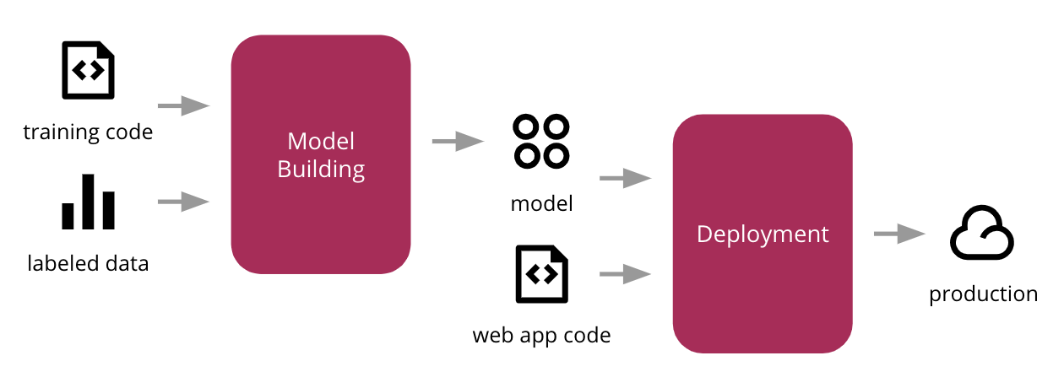
DEPLOYMENT
It is the process of making your trained machine learning model available for use in a production environment, where it can interact with real users and data
Steps of Deployment
Model Training and Evaluation:
Before deployment, the machine learning model is trained and evaluated using historical data to ensure it performs well. Once a model is chosen based on its performance metrics (such as accuracy, ROC curve, etc.), it's ready for deployment.
2. Serialization of the Model:
The model is serialized, or saved, so it can be reused without needing to retrain it. In Python, this is often done using libraries like Pickle . Serialization converts the model into a format that can be stored in a file and loaded later.
3. Using Streamlit for Web Applications:
Streamlit is a popular Python library for building interactive web applications. It allows you to create a web interface where users can input data (like text in an NLP project) and receive predictions (like whether the news is true or fake).

Slide 14
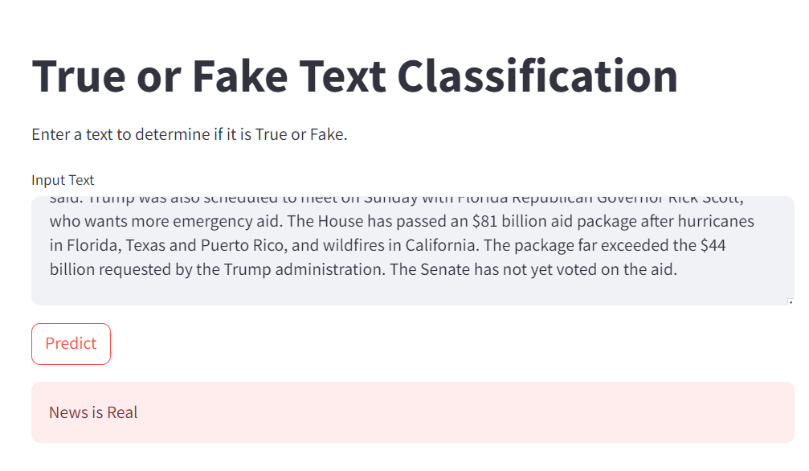
Model For Deployment: Random Forest Classifier
Prediction After Deployment

Slide 15
Conclusion The successful deployment of the real vs. fake news classification model is a testament to the power of machine learning and modern web technologies in solving complex societal challenges. By making this tool widely accessible, we take a step towards a more informed and discerning public, capable of navigating the complexities of today's information landscape.

Slide 16


